Slide 1
Event Storming
or How I learned to stop worrying and love meetings

Slide 2
Goal
To give an introduction into Domain Driven Design Strategic Patterns using an interactive Event Storming exercise

Slide 3

Car Simulator
We will be designing a driving game that will work with VR devices.
Players will be able to drive, design, buy and sell new and used cars, and interact with other players

Slide 4
The First MMF
Provide a realistic driving experience in ideal weather conditions
Driving will result in normal wear and tear on the vehicle
A standard set of cars can be bought and sold in the market place with limited customizations
Used cars can be sold to other players at the seller’s price
Cars can be loaned out to other players

Slide 5
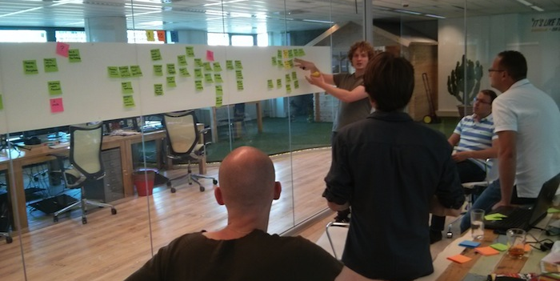
What is event storming?

Slide 6
Roles
Developers: Members of the team developing the system
Domain Experts: Members of the team with expert knowledge in all or part of a given domain
I will serve as facilitator and Product Owner for this exercise

Slide 7

Domain Events
An important event in the context of the Domain
Internal and external processes will then consume these events

Slide 8

Step #1: Identifying the Domain Events
For review, Domain Events are an important event within a bounded context
Place Domain Events in chronological order on a sticky note
Events that happen concurrently are placed within the same vertical plane

Slide 9

Step #2: Identifying the Cause
Identify the Command that caused each Domain Event
Write the Command on a sticky note
Place directly to the left of the Domain Event
Specific Roles are written on a bright yellow sticky in the lower left corner of the command
Processes that are kicked off by Commands are written on Lilac colored sticky notes

Slide 10

Step #3: Who did it?
Identify the associated Entity (Aggregate) to each Command/Event pair
Place it on a sticky behind the pair
Note common Entities without rearranging them

Slide 11
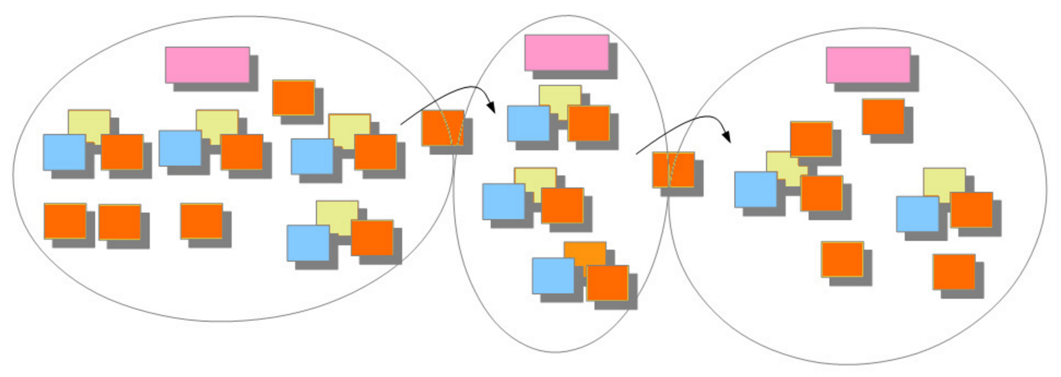
Step #4: The Dividing Line
Look for divisions in the model to identify Bounded Contexts
Draw solid lines for Bounded Contexts and dashed Lines for subdomains
Use Pink Sticky Notes to name the Bounded Contexts
Draw arrows to show the flow of information across Contexts

Slide 12

Step #5: What do we see?
Identify any Views and put them within each Bounded Context
Role specific Views have a bright yellow sticky with the Role
If necessary, draw a quick mock up of the View

Slide 13

Focusing on Language
The definition of a customer may have different meaning based on perspective
Ubiquitous Language means that each Bounded Context has its own vocabulary

Slide 14
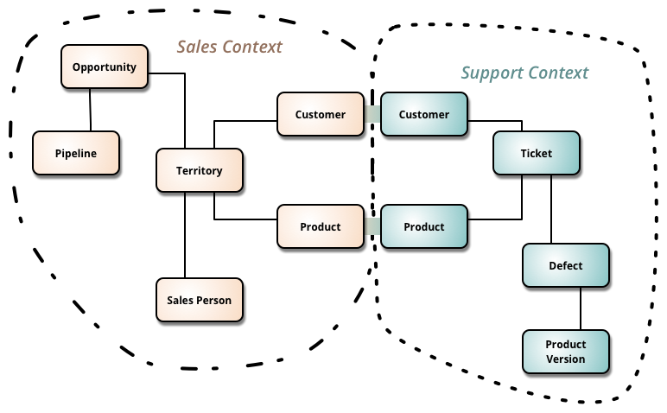
What is a Bounded Context?
A bounded context is a linguistic boundary around Ubiquitous Language
Like concepts go together while foreign concepts are outside

Slide 15

Focusing on the Core
Focus on developing the driving portion first, which is the Core Domain
Supporting Subdomains and Generic Domains should be off the shelf or have less time spent

Slide 16
Summing Up
Through this exercise I have given a high level overview of Domain Driven Design and its Strategic Patterns
Tactical Patterns focus on the code itself and is another talk(s) altogether
Any questions?

